Slide 1
XSens DOT
Both Wrists Data

Slide 2
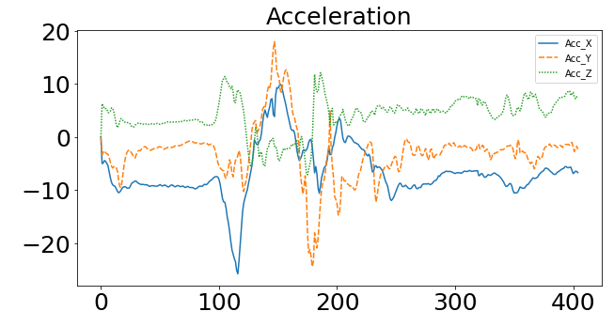
Left Wrist:
Wrist up in Waack Pose
Hand Down/Idle
Wrist on Right Elbow
Notes:
Left Wrist

Slide 3
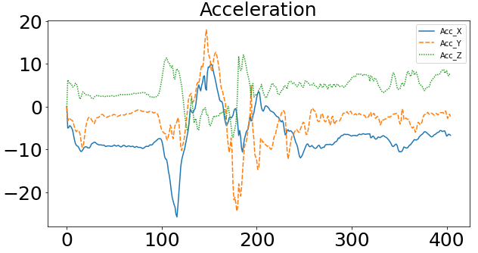
Wrist up in Waack Pose
Hand Down/Idle
Wrist on Right Elbow

Slide 4
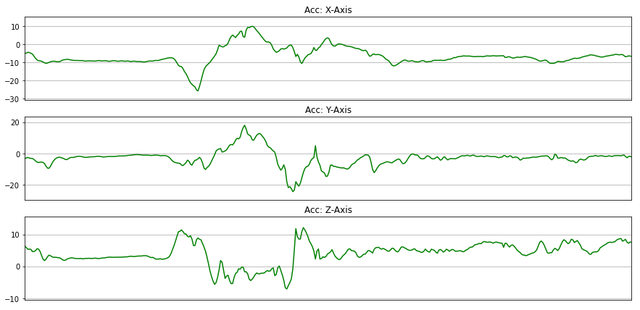
Hand Down/Idle
Wrist up in Waack Pose
Wrist on Right Elbow
Hand Down/Idle
Wrist up in Waack Pose
Wrist on Right Elbow
Wrist up in Waack Pose
Hand Down/Idle
Wrist on Right Elbow

Slide 5
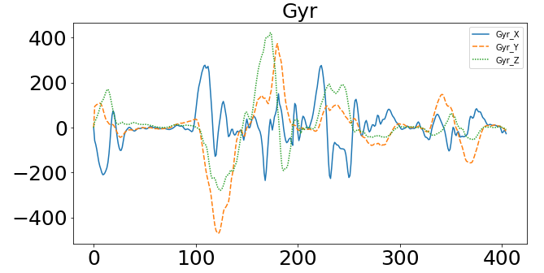

Slide 6
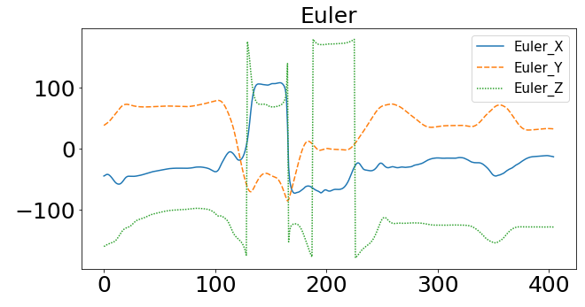

Slide 7
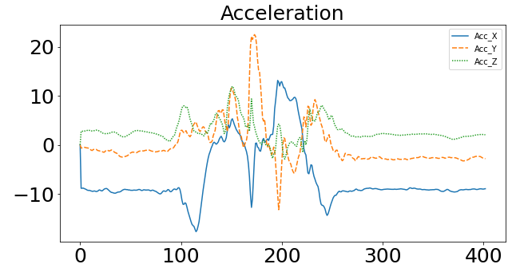
Right Wrist:
Wrist up in Waack Pose
Wrist on Left Elbow
Hand Down/Idle
Notes:
Right Wrist

Slide 8
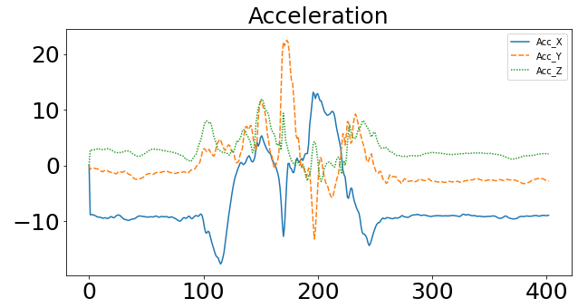
Wrist up in Waack Pose
Wrist on Right Elbow
Hand Down/Idle

Slide 9
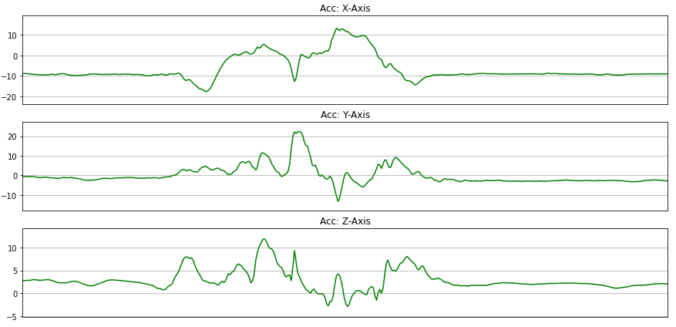
Wrist on Left Elbow
Hand Down/Idle
Wrist up in Waack Pose
Wrist on Left Elbow
Wrist up in Waack Pose
Hand Down/Idle
Wrist on Left Elbow
Wrist up in Waack Pose
Hand Down/Idle

Slide 10
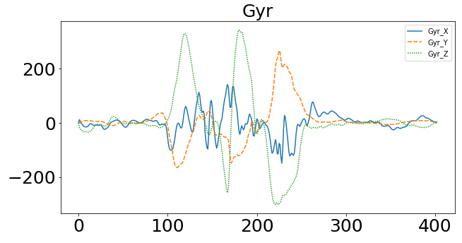

Slide 11
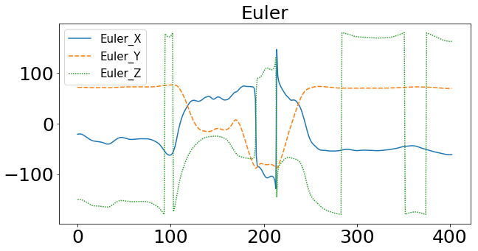

Slide 12
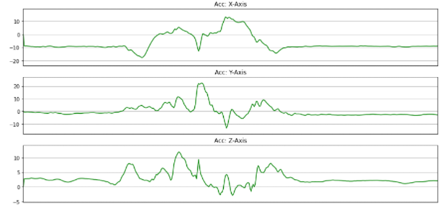
CNN: Right Wrist

Slide 14
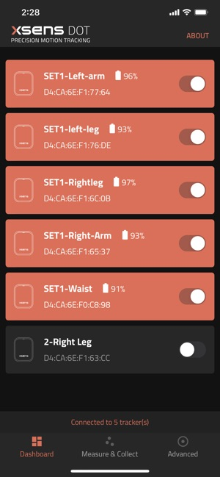
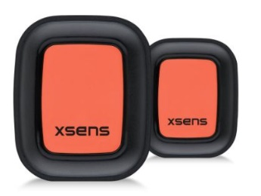

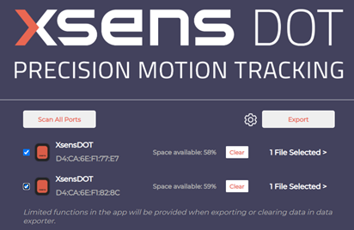

Approach
Apply to both wrists
Connect sensors
XSens DOT Phone App
XSens DOT
Capture dance motion
Send accelerometer data
XSens DOT Data Exporter
Jupyter/Python

Slide 15
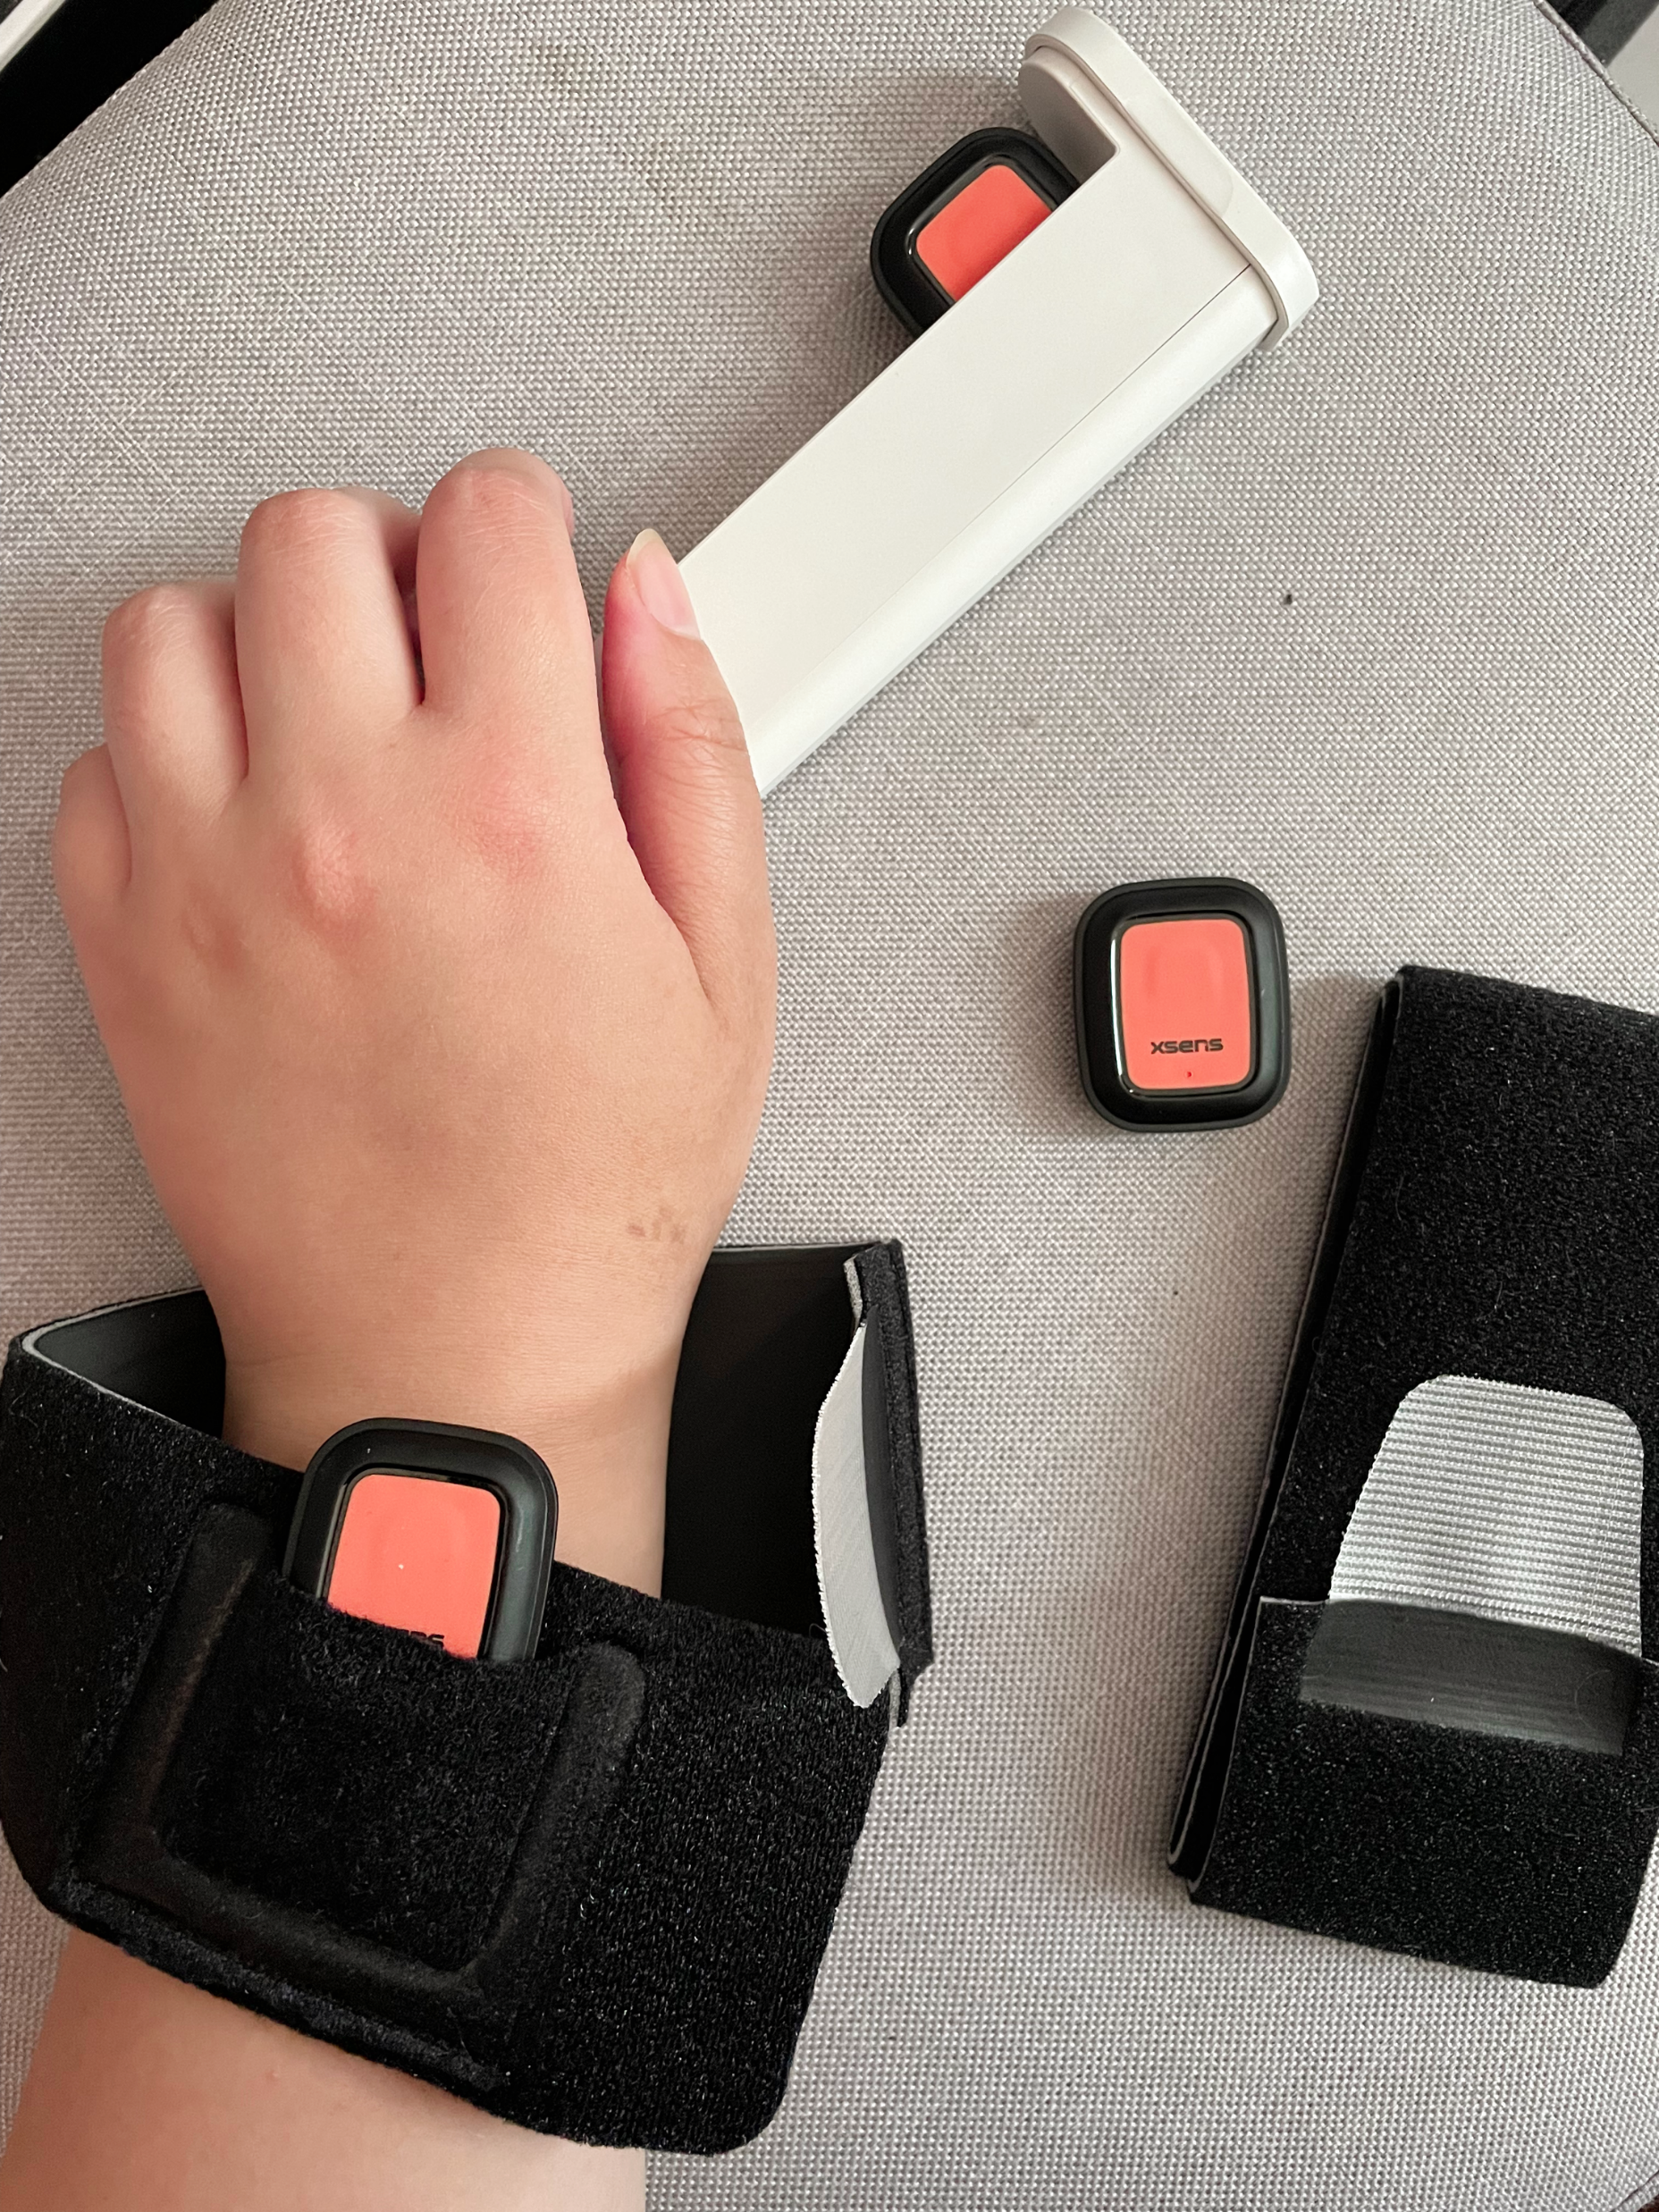
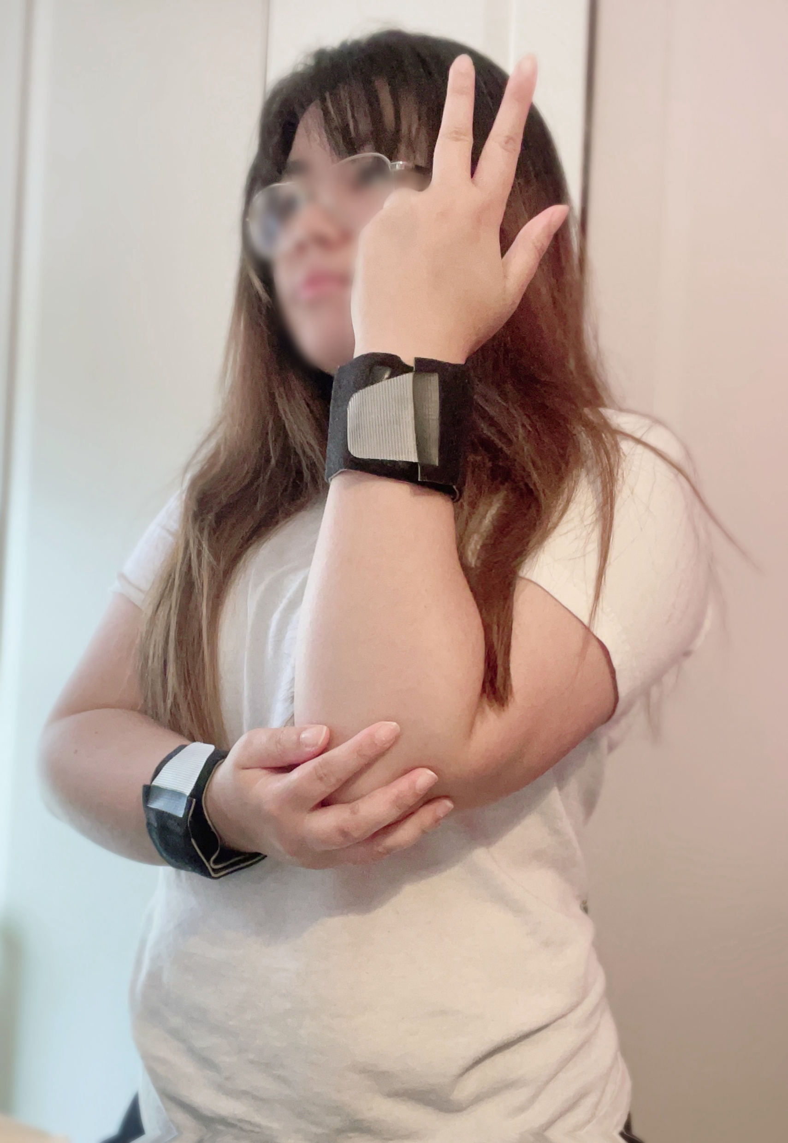
Approach
Apply to both wrists
Connect sensors
Capture dance motion
XSens DOT
XSens DOT Phone App
Export data from Xsens App
Send accelerometer data
Dance Demonstration
Jupyter/Python
XSens DOT Data Exporter

Slide 16
 | Accuracy
Sukor et al.
Bayat et al.
da Silva et al. | 90%
Drumond et al. | 96%
Gomes et al.
Pavai

Slide 17
Using wearable inertial sensors to track everyday human motion has been a popular subject in previous papers in classifying and recognising human activities.
Plenty of projects involving human activity recognition have already been explored and published.
However, identifying dance motions from wearable inertial sensors to determine the accuracy of a dance choreography has not been well inspected.

Slide 18

Author | Data | Approach | Accuracy
Bayat et al. | Accelerometer | Combination of Classifiers: Multilayer Perceptron, LogitBoost and SVM | 91.15%
Gomes et al. | Accelerometer | KNN Combination of Classifiers: Random Forest & KNN | 79% 78%
Sukor et al. | Accelerometer | Multilayer Perceptron Neural Network | 96.11%
da Silva et al. | Motion Capture | LSTM | 95%
Drumond et al. | Accelerometer | LSTM | 96%
Pavai | Accelerometer | Bidirectional LSTM | 90+%
Our Approach | Accelerometer | Bidirectional LSTM | 60+%

